Slide 1
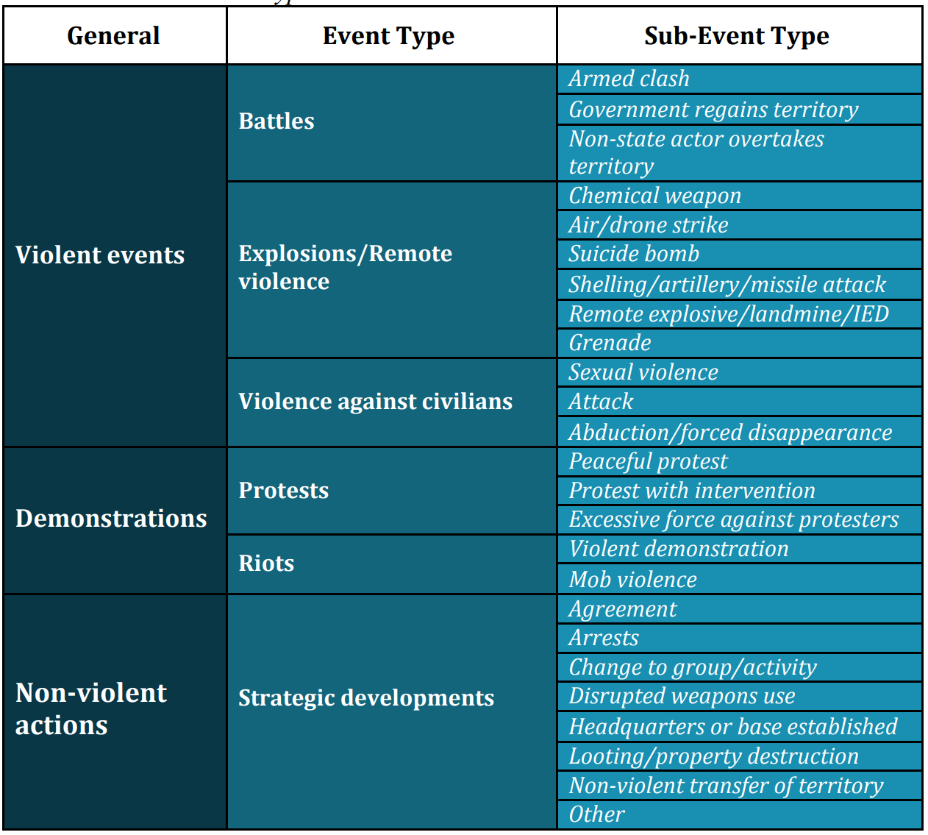
Battle: violent interaction between two politically organized armed groups at a particular time and location.
Short-lived territorial exchanges that do not last for more than one day are coded as ‘Armed clash’.
Explosions/Remote violence: one-sided violent events in which the tool for engaging in conflict creates asymmetry by taking away the ability of the target to respond
Violence against civilians: violent events where an organised armed group deliberately inflicts violence upon unarmed non-combatants
Protest: public demonstration in which the participants do not engage in violence, though violence may be used against them
Riots: violent events where demonstrators or mobs engage in disruptive acts
Strategic developments: pivotal events within campaigns of political violence
ASSOC_ACTOR: record the associated groups for specific events and the identity of specific actors e.g. allies in actions, victims of an attack

Slide 2
INTER: change over time. If a rebel group secedes from a state, its armed agents become the armed wing of a political party within the new regime structure or the government forces of the new state
1: State Forces - collective actors that are recognised to perform government functions, including military and police, over a given territory
2: Rebel Groups - political organizations whose goal is to counter an established national governing regime by violent acts
3: Political Militias - diverse set of violent actors created for a specific purpose or during a specific time period and for the furtherance of a political purpose by violence (not seeking the removal of a national power)
4: Identity Militias - signifies armed and violent groups organized around a collective, common feature including community, ethnicity, region, religion or livelihood (act locally, in the pursuance of local goals, resources, power, security, and retribution)
5: Rioters - engage in violence during demonstrations or in spontaneous acts of disorganised violence
6: Protesters - peaceful, unarmed demonstrators
7: Civilians - victims of violent acts
8: External/Other Forces - international organisations, state forces active outside of their main country of operation, private security firms
GEO_PRECISION
1: coordinates are available
2: small part of a region, notes a general area, a town with georeferenced coordinates to represent that area is chosen
3: larger region is mentioned, the closest natural location noted in reporting is chosen to represent the region
TIME_PRECISION 1: actual date
2: during a specific week or in the weekend (middle of week)
3: within a particular month (middle of month)

Slide 3
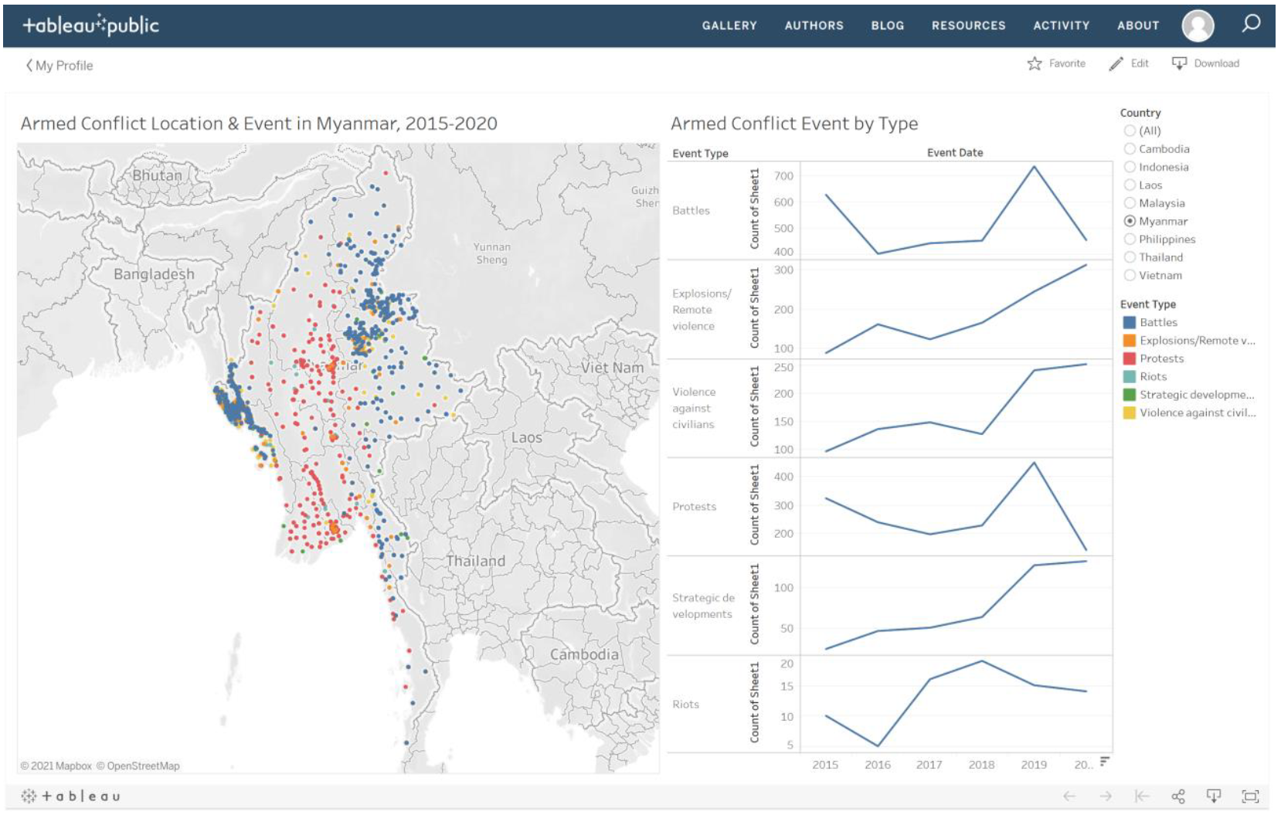
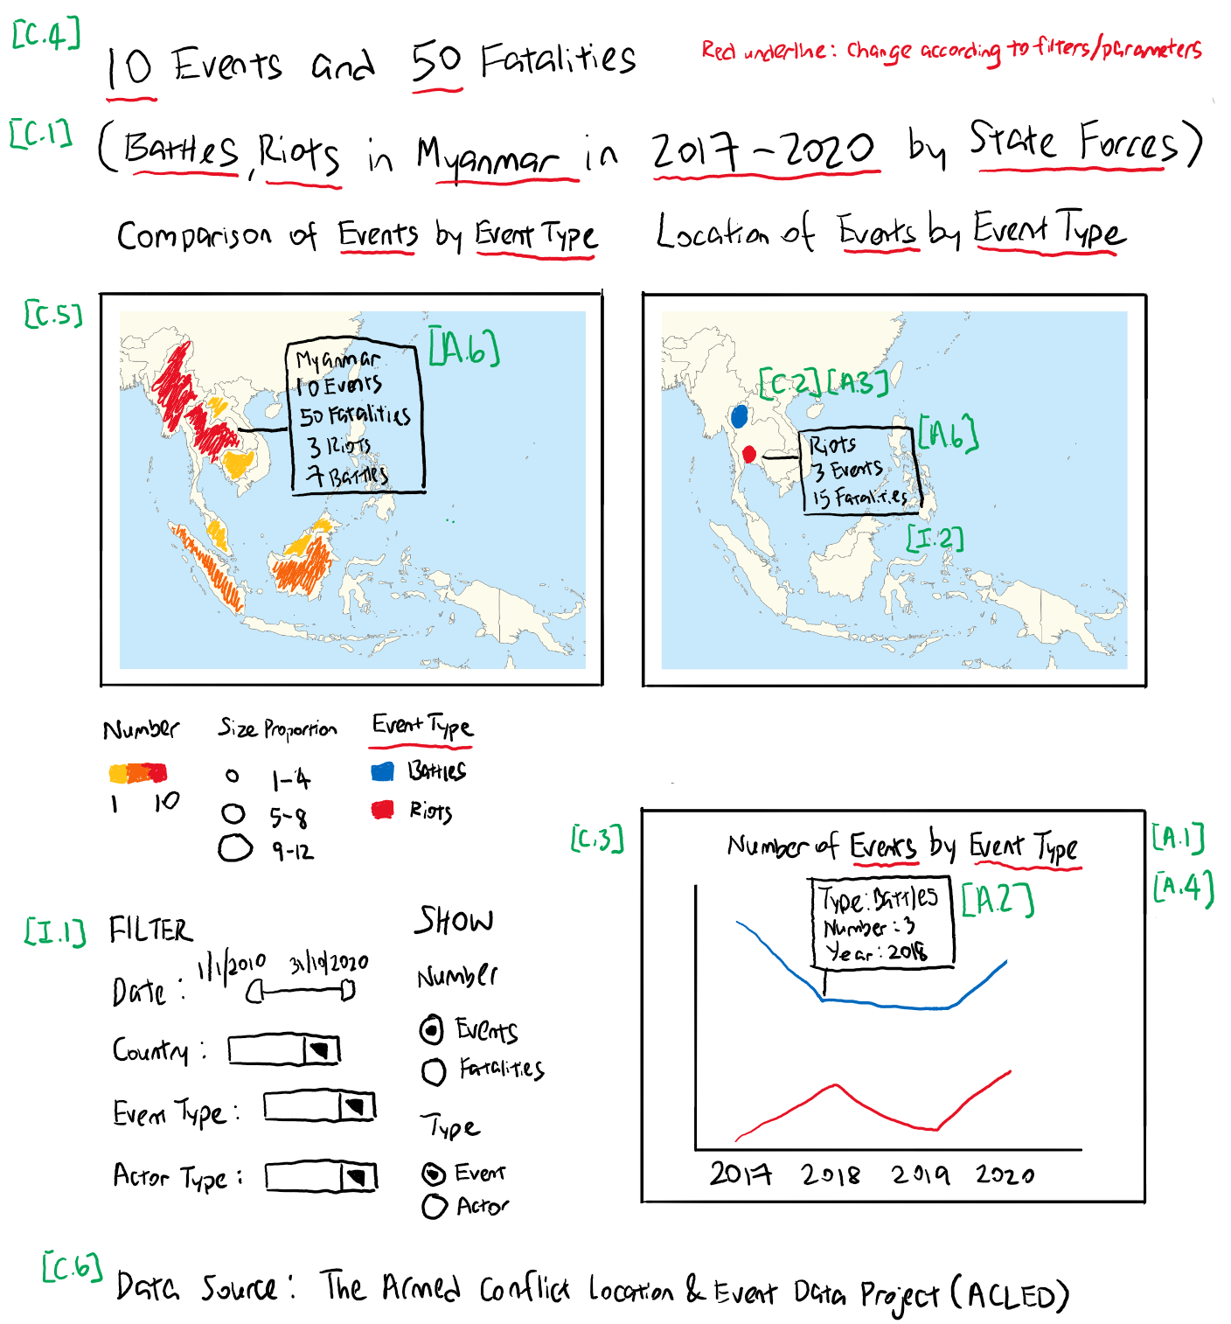
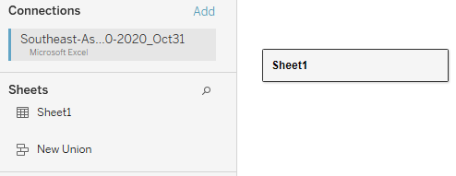

Slide 4
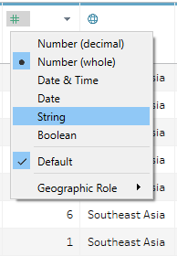
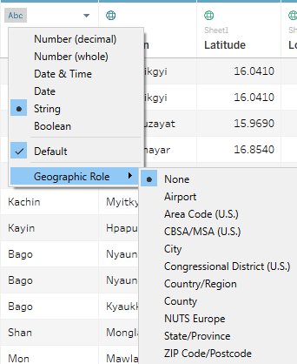
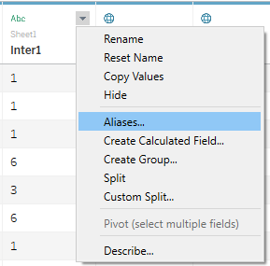
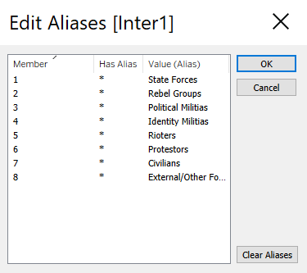
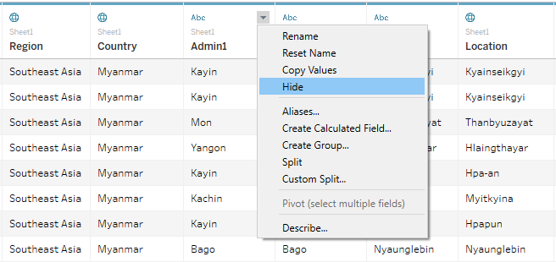

Slide 5
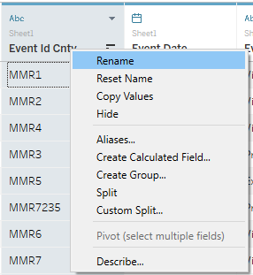
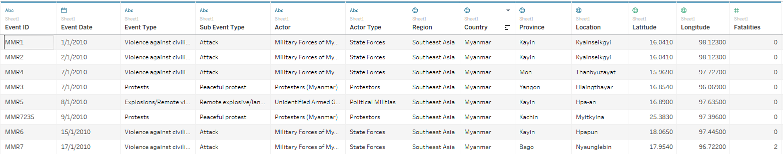
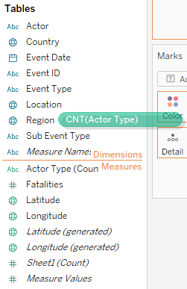
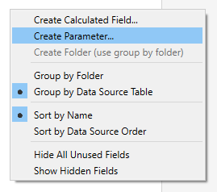
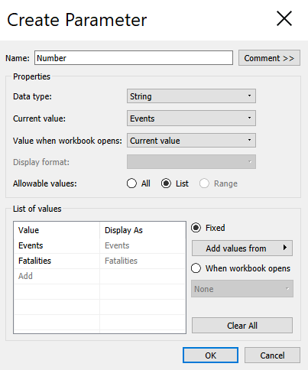
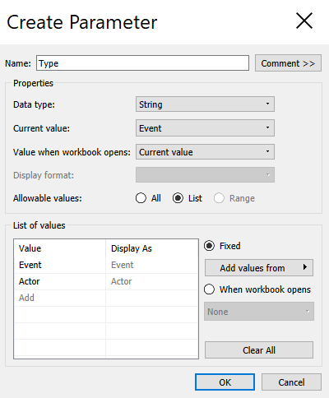

Slide 6
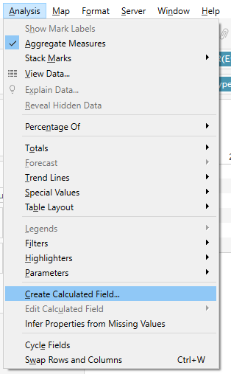
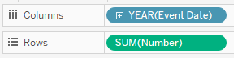
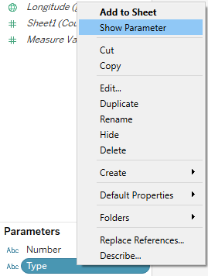
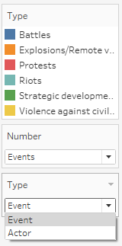
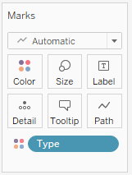
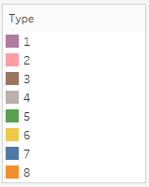
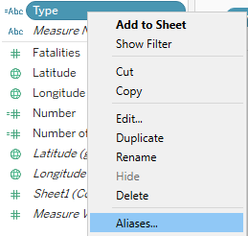
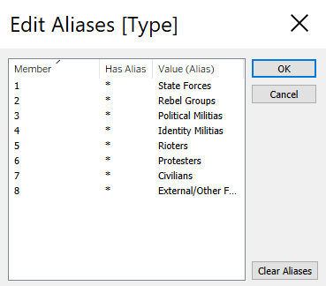
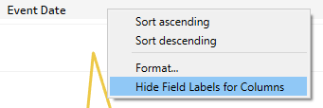
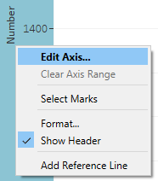
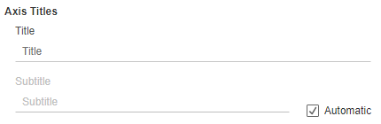
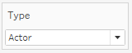
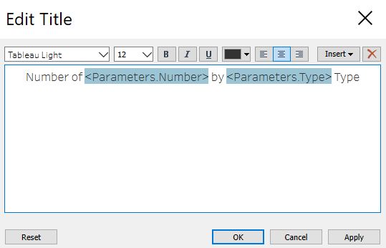
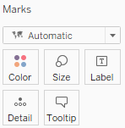
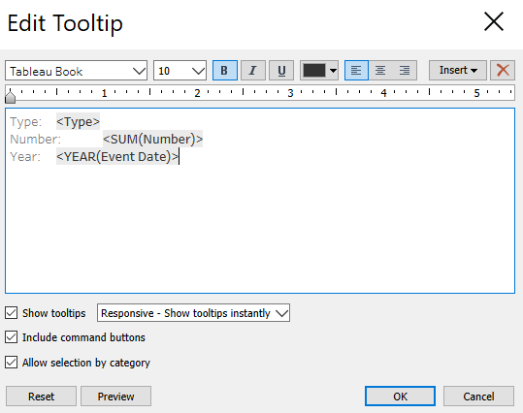
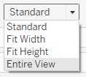



Slide 7
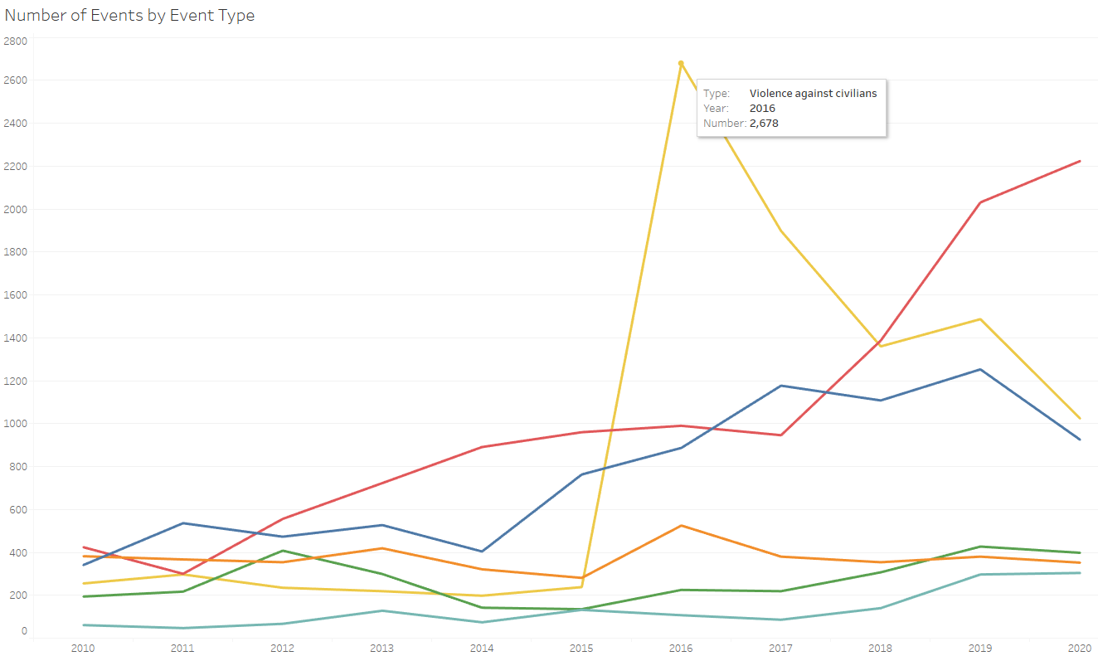

Slide 8
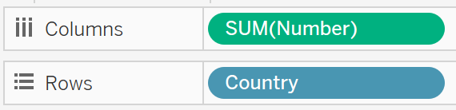
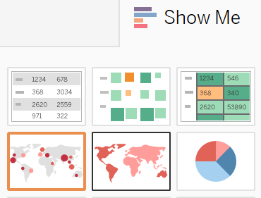
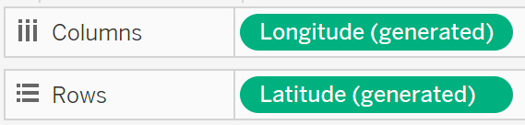
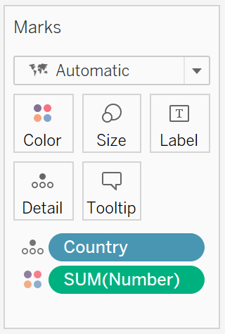
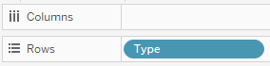
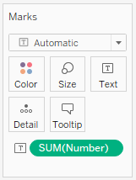
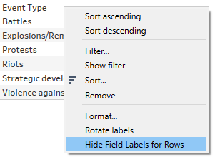
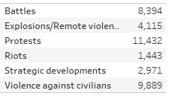
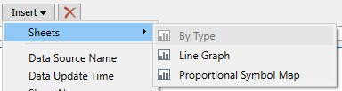
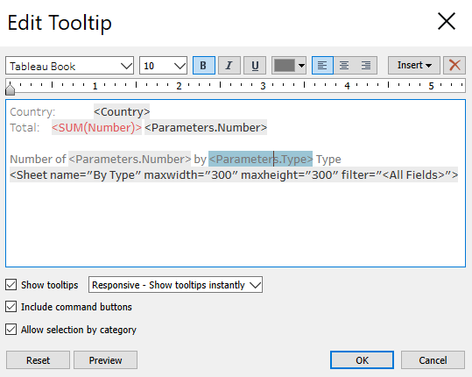


Slide 9

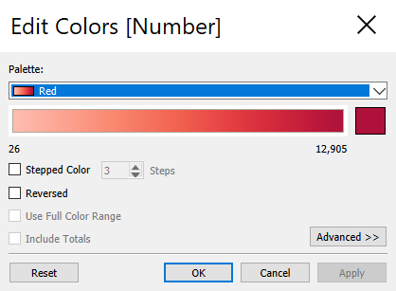
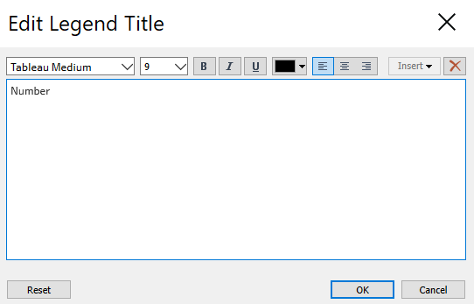
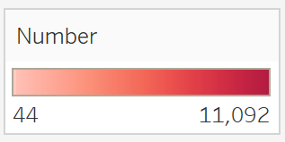
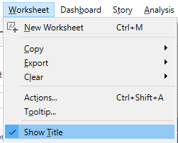
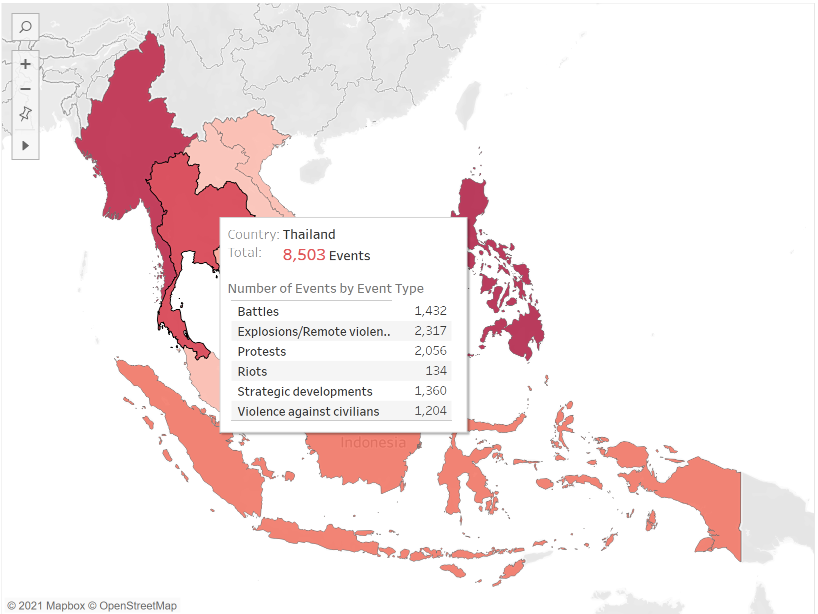


Slide 10
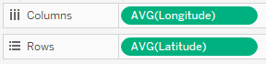
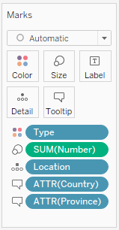
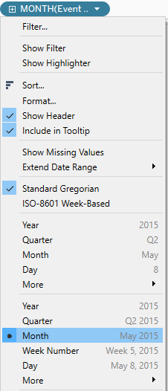











Slide 11







Slide 12
















Slide 13







Slide 14













Slide 15


Slide 16
10,482 events
11,092 events
2,678 events
2,224 events

Slide 17



8,913 fatalities
12,905 fatalities
3,569 fatalities

Slide 18



National Capital Region
Metropolitan Manila

Slide 19



National Capital Region
Metropolitan Manila

Slide 20

1,050 events

Slide 21

973 events

Slide 22



Bangkok
Yala, Pattani, Narathiwat
896 events
679 events
71 events

Slide 23

679 events

Slide 24

395 fatalities
65 fatalities

